Slide 1


TOPIC:
BE PROJECT PHASE-2
GENERATING A DECENTRALIZED ARCHITECTURE FOR DATA PRIVACY AND SHARING USING BLOCKCHAIN TECHNOLOGY

Slide 2
GROUP 5
TEAM MEMBERS :
ANIRVIN VISHWANATHAN
KANISHKA KOTHARI
AKASH MAHALE
MENTOR:
Dr. PREETIDA JANI

Slide 3
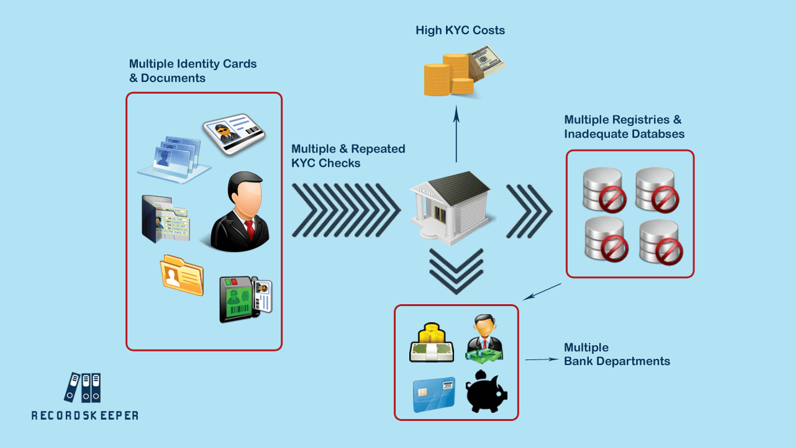
PROBLEMS IN CURRENT KYC PROCESS:
Manual Process -
a. Increased time consumption.
b. Error prone.
Submission of multiple documents.
Repetitive checks for data updation.
Intra bank departments asking for similar information from customer.
Inter bank KYC scheme isn’t followed.
Centralized Architecture.

Slide 4
OBJECTIVE:
Independent and Autonomous System.
To develop a Distributed and Decentralized architecture.
Eliminating Repetitive Submission Of Documents.
To make System More Secured and Systematic.
A protected Database of E-KYCs for data sharing.

Slide 5
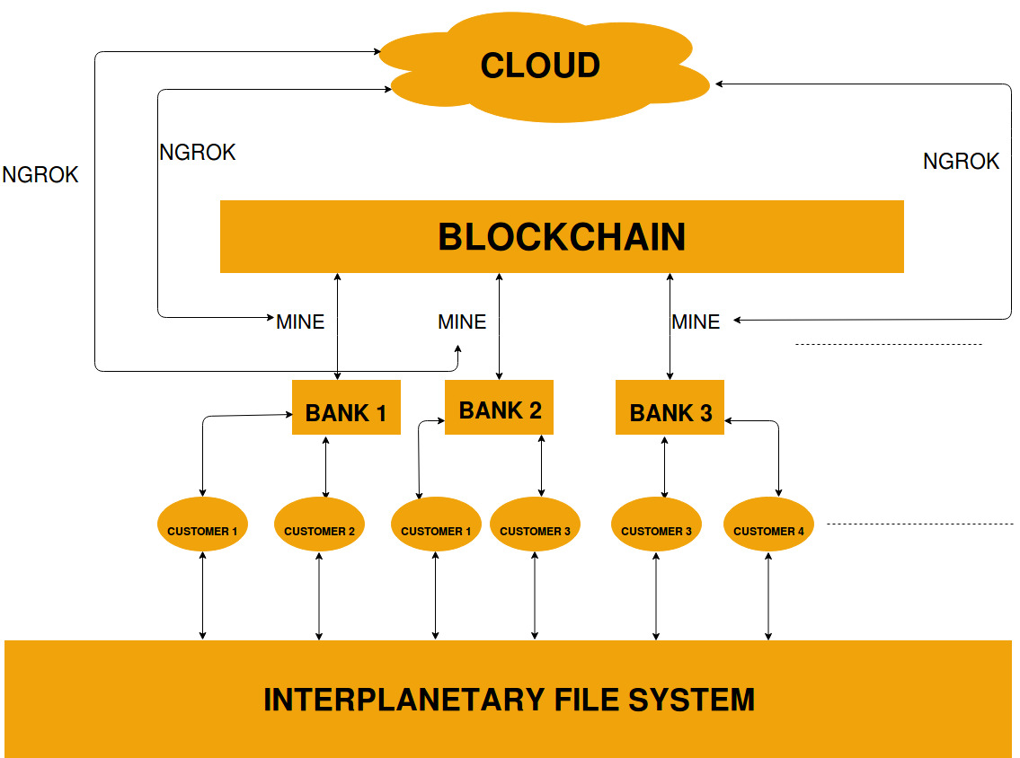
PROPOSED ARCHITECTURE

Slide 6
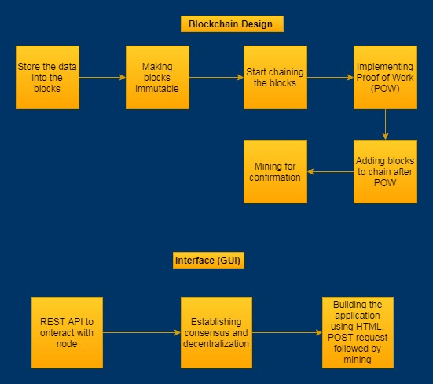
SOFTWARE LOGIC DESIGN

Slide 7
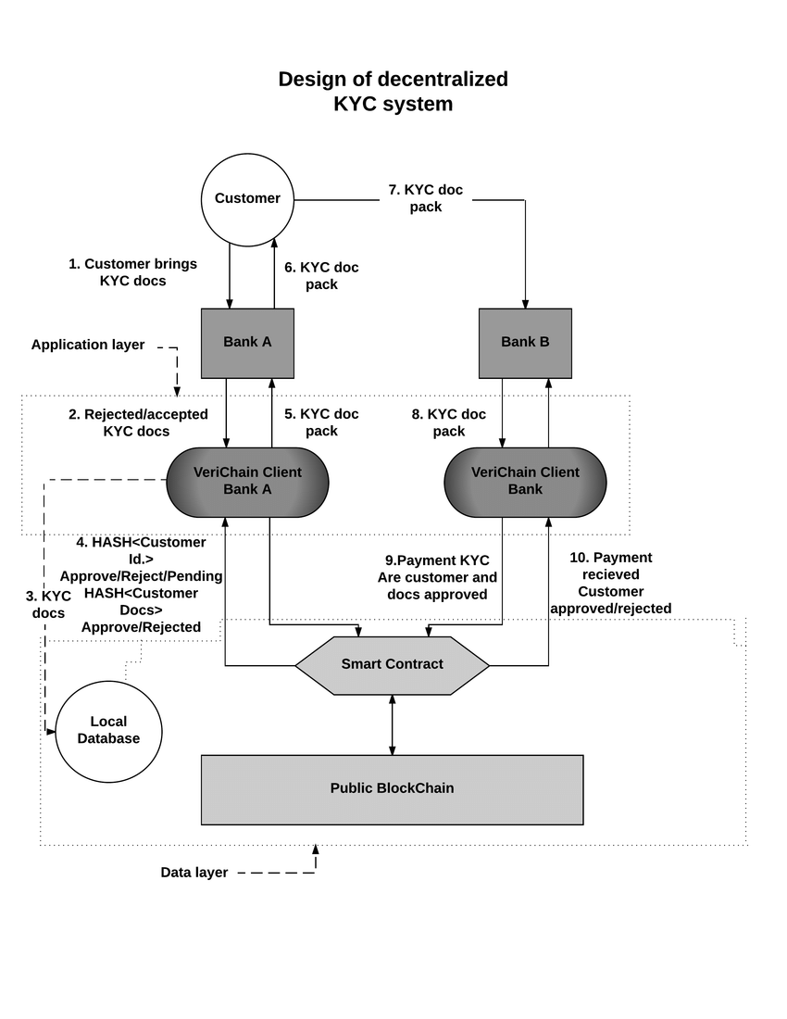
OUR ARCHITECTURE

Slide 8
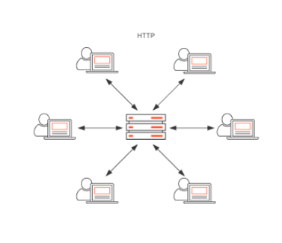
INTER PLANETARY FILE SYSTEM(IPFS) (1 / 2)
HTTP:
Location-based addressing.
It uses IP-addresses.
Process eats bandwidth
Downloads a file from a single server at a time.
Powerful entities can block access to certain locations.

Slide 9
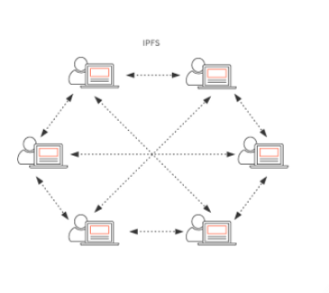
INTER PLANETARY FILE SYSTEM(IPFS) (2 / 2)
IPFS:
IPFS doesn’t have a single point of failure.
Peer-to-peer and distributed file system.
Internet censorship will largely be impossible.
Security also increases — DDos attacks, for example, wouldn’t work.
Speed is another factor that increases.

Slide 10
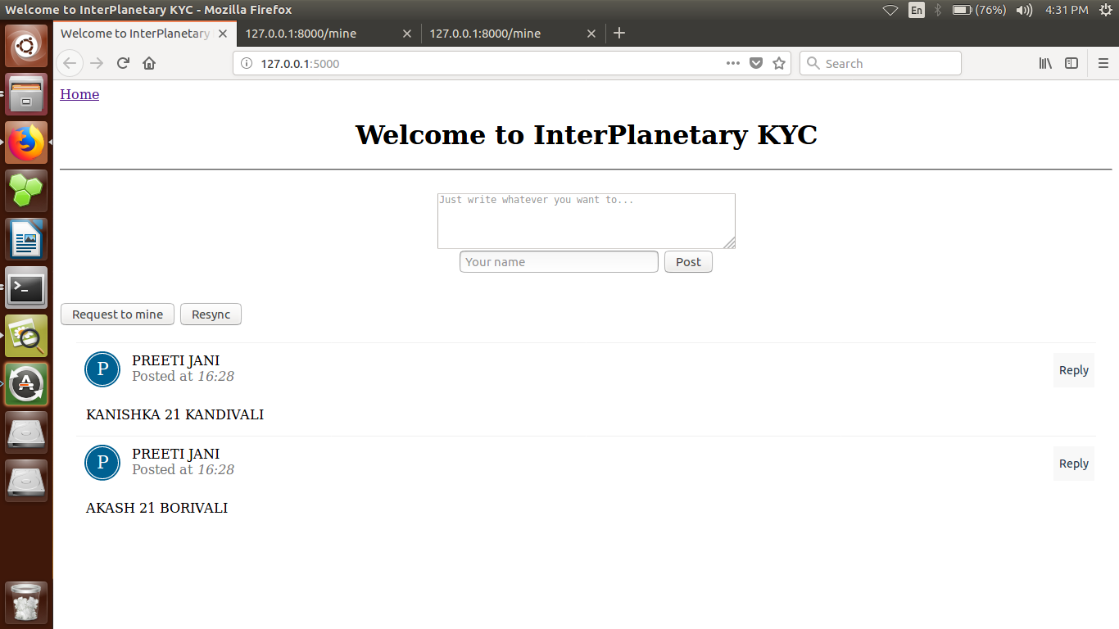
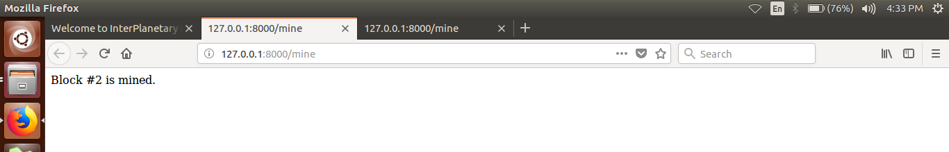
RESULT AND SIMULATION

Slide 11
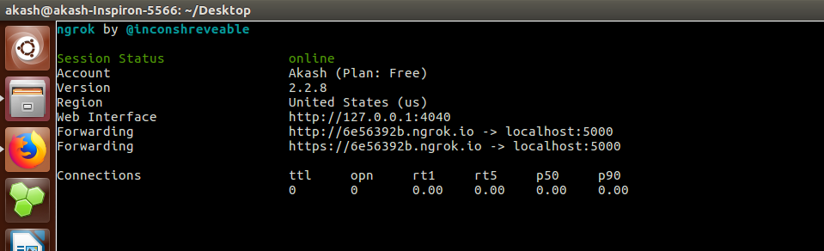
RESULT AND SIMULATION

Slide 12
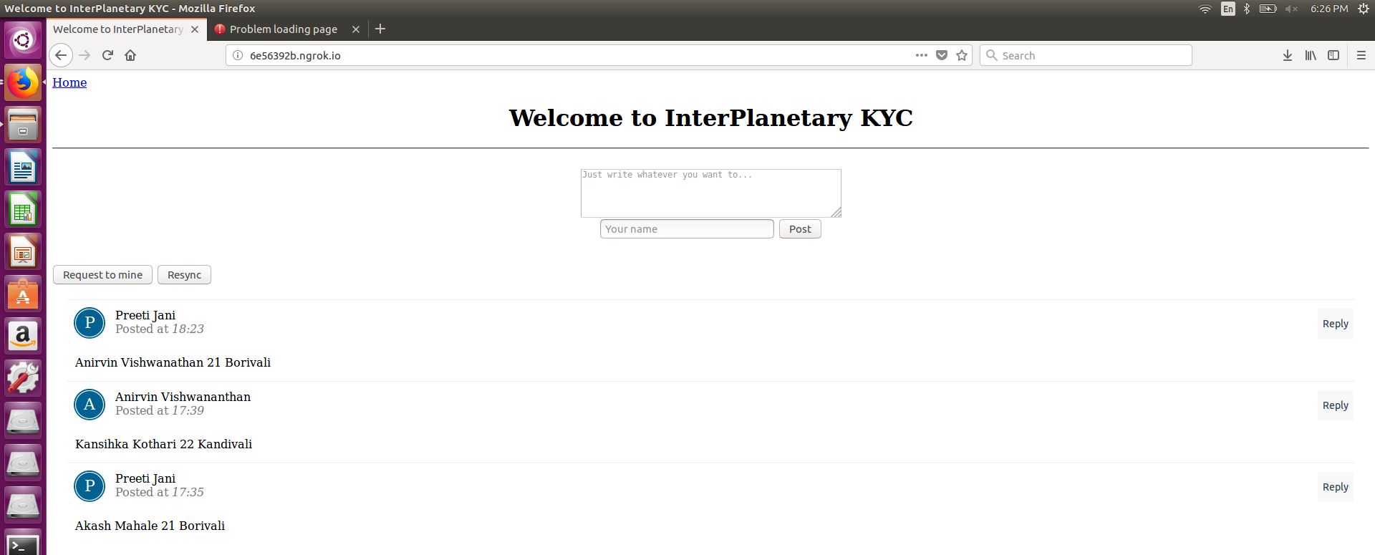
RESULT AND SIMULATION

Slide 13

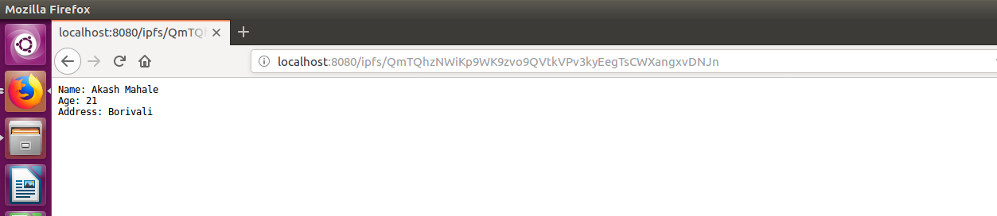
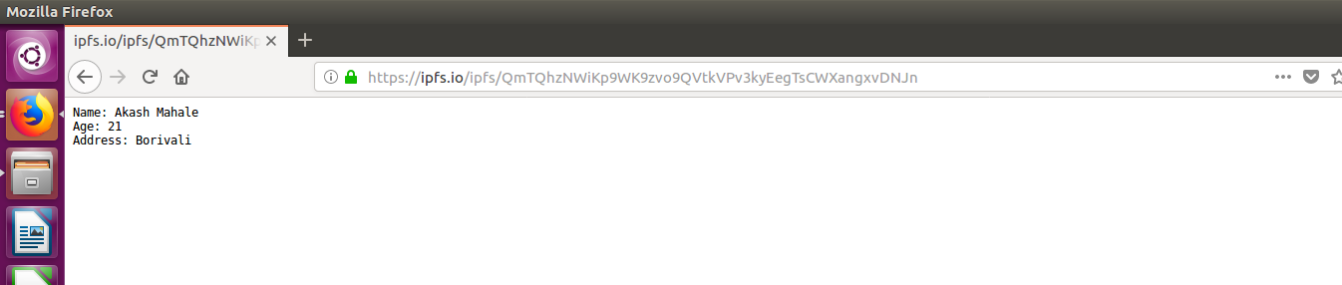
RESULT AND SIMULATION

Slide 14
FURTHER PLANNING
Cloud Setup (AWS OR IBM)
Biometrics/ Retinal Authentication
Database for IPFS hash and Biometrics

Slide 15
THANK YOU !!

